Slide 1
Data Communications & Security
Lecture 4 (week 4)
Transport Layer part 1: UDP and RDT

Slide 2


Chapter 3
Transport Layer
A note on the use of these Powerpoint slides:
We’re making these slides freely available to all (faculty, students, readers). They’re in PowerPoint form so you see the animations; and can add, modify, and delete slides (including this one) and slide content to suit your needs. They obviously represent a lot of work on our part. In return for use, we only ask the following:
Computer Networking: A Top Down Approach
If you use these slides (e.g., in a class) that you mention their source (after all, we’d like people to use our book!)
If you post any slides on a www site, that you note that they are adapted from (or perhaps identical to) our slides, and note our copyright of this material.
Thanks and enjoy! JFK/KWR
All material copyright 1996-2016
J.F Kurose and K.W. Ross, All Rights Reserved
7th edition
Jim Kurose, Keith Ross
Pearson/Addison Wesley
April 2016
Transport Layer
2-<number>

Slide 3
Time for a quiz!
Get your phones/laptops out and go here:
http://www.kahoot.it
And type in the PIN
Notes:
https://create.kahoot.it/login
Sign in with Google (jha…wav22)
MyKahoots
Week2 Play
Classic Start Next

Slide 4
Chapter 3: Transport Layer
our goals:
understand principles behind transport layer services:
  multiplexing, demultiplexing
  reliable data transfer
  flow control
  congestion control
learn about Internet transport layer protocols:
  UDP: connectionless transport
  TCP: connection-oriented reliable transport
  TCP congestion control
Transport Layer
3-<number>

Slide 5
Chapter 3 outline
3.1 transport-layer services
3.2 multiplexing and demultiplexing
3.3 connectionless transport: UDP
3.4 principles of reliable data transfer
3.5 connection-oriented transport: TCP
  segment structure
  reliable data transfer
  flow control
  connection management
3.6 principles of congestion control
3.7 TCP congestion control
This week
Next week
Transport Layer
3-<number>

Slide 6

















Transport services and protocols
application
transport
network
data link
physical
provide logical communication between app processes running on different hosts.
transport protocols run in end systems.
  send side: breaks app messages into segments, passes to network layer.
  rcv side: reassembles segments into messages, passes to app layer.
more than one transport protocol available to apps.
  Internet: TCP and UDP.
logical end-end transport
application
transport
network
data link
physical
Transport Layer
3-<number>
Notes:
Logical=abstract model (compare Newtonian physics with Einsteinian physics, “Files” with inodes

Slide 7
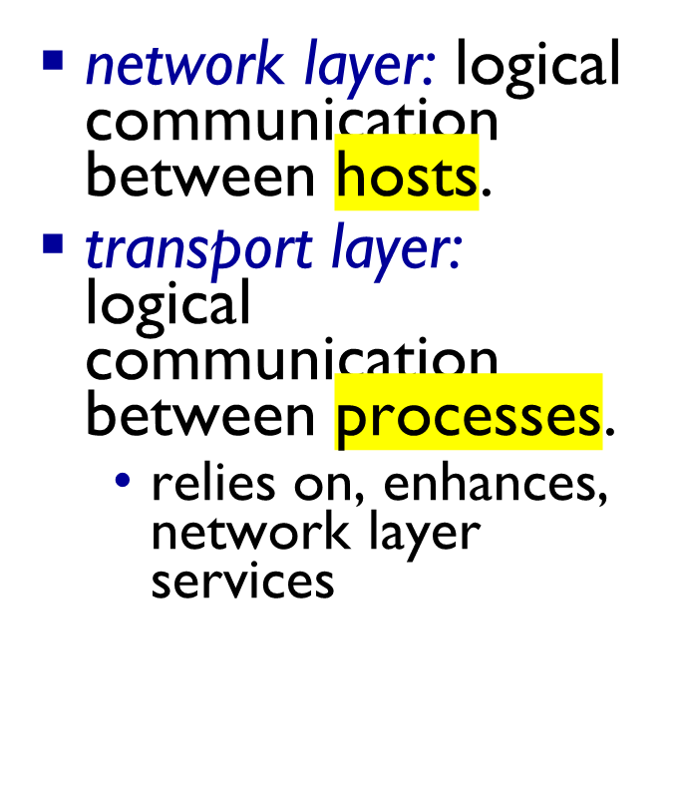
Transport vs. network layer
household analogy:
12 kids in Ann’s house sending letters to 12 kids in Bill’s house:
hosts = houses
processes = kids
app messages = letters in envelopes
transport protocol = Ann and Bill who demux to in-house siblings
network-layer protocol = postal service
Transport Layer
3-<number>

Slide 8
Internet transport-layer protocols
reliable, in-order delivery (TCP)
  congestion control
  flow control
  connection setup
unreliable, unordered delivery: UDP
  no-frills extension of “best-effort” IP
services not available:
  delay guarantees
  bandwidth guarantees
application
transport
network
data link
physical
network
data link
physical
network
data link
physical
network
data link
physical
logical end-end transport
network
data link
physical
network
data link
physical
network
data link
physical
network
data link
physical
application
transport
network
data link
physical
Transport Layer
3-<number>

Slide 9
Chapter 3 outline
3.1 transport-layer services
3.2 multiplexing and demultiplexing
3.3 connectionless transport: UDP
3.4 principles of reliable data transfer
3.5 connection-oriented transport: TCP
  segment structure
  reliable data transfer
  flow control
  connection management
3.6 principles of congestion control
3.7 TCP congestion control
Transport Layer
3-<number>

Slide 10

Multiplexing/demultiplexing
multiplexing at sender:
handle data from multiple
sockets, add transport header (later used for demultiplexing)
demultiplexing at receiver:
use header info to deliver
received segments to correct
socket
application
application
P1
P2
application
socket
P3
transport
P4
process
transport
network
transport
network
link
network
link
physical
link
physical
physical
Transport Layer
3-<number>

Slide 11
How demultiplexing works
host receives IP datagrams
  each datagram has source IP address, destination IP address.
  each datagram carries one transport-layer segment.
  each segment has source, destination port number.
host uses IP addresses & port numbers to direct segment to appropriate socket.
32 bits
source port #
dest port #
other header fields
application
data
(payload)
TCP/UDP segment format
Transport Layer
3-<number>

Slide 12
Connectionless demultiplexing
recall: when creating datagram to send into UDP socket, must specify
  destination IP address
  destination port #
recall: created socket has host-local port #:
DatagramSocket mySocket1 = new DatagramSocket(12534);
when host receives UDP segment:
  checks destination port # in segment,
  directs UDP segment to socket with that port #
IP datagrams with same dest. port #, but different source IP addresses and/or source port numbers will be directed to same socket at dest
Transport Layer
3-<number>

Slide 13
Connectionless demux: example
DatagramSocket serverSocket = new DatagramSocket
(6428);
DatagramSocket mySocket2 = new DatagramSocket
(9157);
DatagramSocket mySocket1 = new DatagramSocket (5775);
application
application
P1
application
P3
P4
transport
transport
network
transport
network
link
network
link
physical
link
physical
physical
source port: 6428
dest port: 9157
source port: ?
dest port: ?
source port: 9157
dest port: 6428
source port: ?
dest port: ?
Transport Layer
3-<number>

Slide 14
Connection-oriented demux
TCP socket identified by 4-tuple:
  source IP address
  source port number
  dest IP address
  dest port number
demux: receiver uses all four values to direct segment to appropriate socket
server host may support many simultaneous TCP sockets:
  each socket identified by its own 4-tuple
web servers have different sockets for each connecting client
  non-persistent HTTP will have different socket for each request
Transport Layer
3-<number>

Slide 15
Connection-oriented demux: example
application
application
P4
P5
P6
application
P3
P2
P3
transport
transport
network
transport
network
link
network
link
physical
link
physical
server: IP address B
physical
host: IP address A
source IP,port: B,80
dest IP,port: A,9157
host: IP address C
source IP,port: C,5775
dest IP,port: B,80
source IP,port: A,9157
dest IP, port: B,80
source IP,port: C,9157
dest IP,port: B,80
three segments, all destined to IP address: B,
dest port: 80 are demultiplexed to different sockets
Transport Layer
3-<number>

Slide 16
Connection-oriented demux: example
threaded server
application
application
application
P4
P3
P3
P2
transport
transport
network
transport
network
link
network
link
physical
link
physical
server: IP address B
physical
host: IP address A
source IP,port: B,80
dest IP,port: A,9157
host: IP address C
source IP,port: C,5775
dest IP,port: B,80
source IP,port: A,9157
dest IP, port: B,80
source IP,port: C,9157
dest IP,port: B,80
Transport Layer
3-<number>

Slide 17
Chapter 3 outline
3.1 transport-layer services
3.2 multiplexing and demultiplexing
3.3 connectionless transport: UDP
3.4 principles of reliable data transfer
3.5 connection-oriented transport: TCP
  segment structure
  reliable data transfer
  flow control
  connection management
3.6 principles of congestion control
3.7 TCP congestion control
Transport Layer
3-<number>

Slide 18
UDP: User Datagram Protocol [RFC 768]
“no frills,” “bare bones” Internet transport protocol
“best effort” service, UDP segments may be:
  lost
  delivered out-of-order to app
connectionless:
  no handshaking between UDP sender, receiver
  each UDP segment handled independently of others
UDP use:
  streaming multimedia apps (loss tolerant, rate sensitive)
  DNS
  SNMP
reliable transfer over UDP:
  add reliability at application layer
  application-specific error recovery!
Transport Layer
3-<number>

Slide 19
UDP: segment header
length, in bytes of UDP segment, including header
32 bits
source port #
dest port #
length
checksum
why is there a UDP?
no connection establishment (which can add delay)
simple: no connection state at sender, receiver
small header size
no congestion control: UDP can blast away as fast as desired
application
data
(payload)
UDP segment format
Transport Layer
3-<number>

Slide 20
UDP checksum
Goal: detect “errors” (e.g., flipped bits) in transmitted segment
sender:
treat segment contents, including header fields, as sequence of 16-bit integers
checksum: addition (one’s complement sum) of segment contents
sender puts checksum value into UDP checksum field
receiver:
compute checksum of received segment
check if computed checksum equals checksum field value:
  NO - error detected
  YES - no error detected. But maybe errors nonetheless? More later ….
Transport Layer
3-<number>

Slide 21
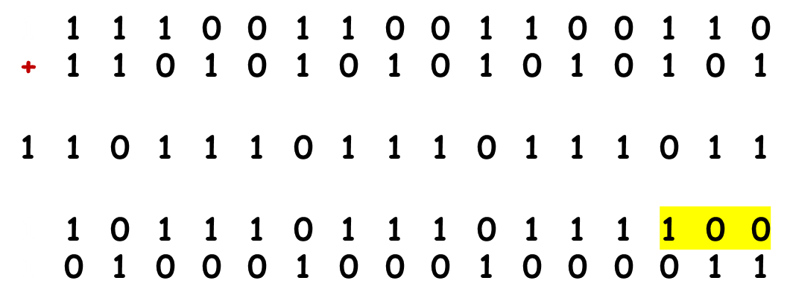
Internet checksum: example
Exam
example: add two 16-bit integers
wraparound
sum
checksum
Note: when adding numbers, a carry-out from the most significant bit needs to be added to the result
* Check out the online interactive exercises for more examples: http://gaia.cs.umass.edu/kurose_ross/interactive/
Transport Layer
3-<number>
Notes:
Kurose and Ross forgot to say anything about wrapping the carry and adding it to low order bit

Slide 22
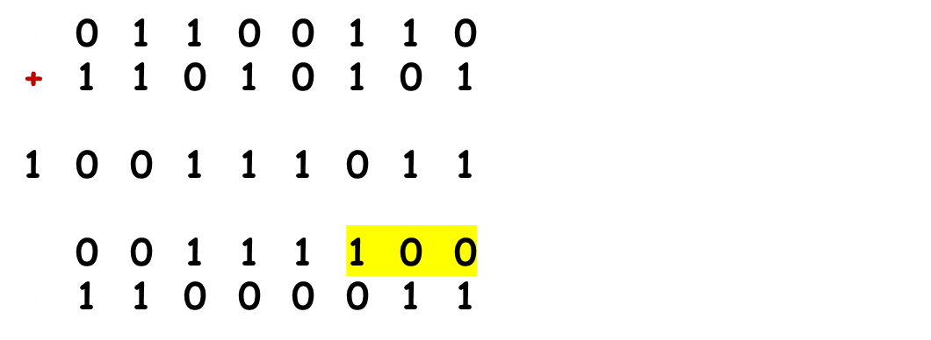
You try:
Exam
test
example: add two 8-bit integers
wraparound
0 0 0 0 0 0 0 1
sum
checksum
Note: when adding numbers, a carry-out from the most significant bit needs to be added to the result
* Check out the online interactive exercises for more examples: http://gaia.cs.umass.edu/kurose_ross/interactive/
Transport Layer
3-<number>
Notes:
Kurose and Ross forgot to say anything about wrapping the carry and adding it to low order bit

Slide 23
Chapter 3 outline
3.1 transport-layer services
3.2 multiplexing and demultiplexing
3.3 connectionless transport: UDP
3.4 principles of reliable data transfer
3.5 connection-oriented transport: TCP
  segment structure
  reliable data transfer
  flow control
  connection management
3.6 principles of congestion control
3.7 TCP congestion control
Transport Layer
3-<number>

Slide 24

Principles of reliable data transfer
important in application, transport, link layers
  top-10 list of important networking topics!
Assignment
Exam
Life!
characteristics of unreliable channel will determine complexity of reliable data transfer protocol (rdt)
Transport Layer
3-<number>

Slide 25
Principles of reliable data transfer
important in application, transport, link layers
  top-10 list of important networking topics!
characteristics of unreliable channel will determine complexity of reliable data transfer protocol (rdt)
Transport Layer
3-<number>

Slide 26
Principles of reliable data transfer
important in application, transport, link layers
  top-10 list of important networking topics!
characteristics of unreliable channel will determine complexity of reliable data transfer protocol (rdt)
Transport Layer
3-<number>

Slide 27

Reliable data transfer: getting started
rdt_send(): called from above, (e.g., by app.). Passed data to
deliver to receiver upper layer
deliver_data(): called by rdt to deliver data to upper
send
side
receive
side
udt_send(): called by rdt,
to transfer packet over
unreliable channel to receiver
rdt_rcv(): called when packet arrives on rcv-side of channel
Transport Layer
3-<number>

Slide 28
Reliable data transfer: getting started
we’ll:
incrementally develop sender, receiver sides of reliable data transfer protocol (rdt)
consider only unidirectional data transfer
  but control info will flow on both directions!
use Finite State Machines (FSM) to specify sender, receiver
event causing state transition
actions taken on state transition
state: when in this “state” next state uniquely determined by next event
state
1
state
2
event
actions
Transport Layer
3-<number>

Slide 29
Whoa! What’s an FSM again?
Time for some research:
Start here:
https://en.wikipedia.org/wiki/Finite-state_machine
Then do an image search:
https://www.google.com.au/search?q=finite+state+machine
Then go to Stack Overflow:
https://stackoverflow.com/questions/6769376/how-to-read-a-fsm-diagram
And don’t panic – it’s just a way of representing where you are in your code.
Transport Layer
3-<number>

Slide 30
rdt1.0: reliable transfer over a reliable channel
underlying channel perfectly reliable
  no bit errors
  no loss of packets
separate FSMs for sender, receiver:
  sender sends data into underlying channel
  receiver reads data from underlying channel
Wait for call from above
rdt_send(data)
Wait for call from below
rdt_rcv(packet)
extract (packet,data)
deliver_data(data)
packet = make_pkt(data)
udt_send(packet)
sender
receiver
Transport Layer
3-<number>

Slide 31
rdt2.0: channel with bit errors
underlying channel may flip bits in packet
  checksum to detect bit errors
the question: how to recover from errors:
  acknowledgements (ACKs): receiver explicitly tells sender that pkt received OK
  negative acknowledgements (NAKs): receiver explicitly tells sender that pkt had errors
  sender retransmits pkt on receipt of NAK
new mechanisms in rdt2.0 (beyond rdt1.0):
  error detection
  receiver feedback: control msgs (ACK,NAK) rcvr->sender
How do humans recover from “errors”
during conversation?
Transport Layer
3-<number>

Slide 32
rdt2.0: channel with bit errors
underlying channel may flip bits in packet
  checksum to detect bit errors
the question: how to recover from errors:
  acknowledgements (ACKs): receiver explicitly tells sender that pkt received OK
  negative acknowledgements (NAKs): receiver explicitly tells sender that pkt had errors
  sender retransmits pkt on receipt of NAK
new mechanisms in rdt2.0 (beyond rdt1.0):
  error detection
  feedback: control msgs (ACK,NAK) from receiver to sender
Transport Layer
3-<number>

Slide 33
FSM stuff
Starting point
Condition
Action
State 0
State 1
Condition
Action
Condition
Λ (no action)
Transport Layer
3-<number>

Slide 34
rdt2.0: FSM specification
rdt_send(data)
sndpkt = make_pkt(data, checksum)
udt_send(sndpkt)
receiver
rdt_rcv(rcvpkt) &&
isNAK(rcvpkt)
Wait for call from above
Wait for ACK or NAK
rdt_rcv(rcvpkt) &&
corrupt(rcvpkt)
udt_send(sndpkt)
udt_send(NAK)
rdt_rcv(rcvpkt) && isACK(rcvpkt)
Λ
Wait for call from below
sender
rdt_rcv(rcvpkt) &&
notcorrupt(rcvpkt)
extract(rcvpkt,data)
deliver_data(data)
udt_send(ACK)
Transport Layer
3-<number>

Slide 35
rdt2.0: operation with no errors
rdt_send(data)
snkpkt = make_pkt(data, checksum)
udt_send(sndpkt)
rdt_rcv(rcvpkt) &&
isNAK(rcvpkt)
Wait for call from above
Wait for ACK or NAK
rdt_rcv(rcvpkt) &&
corrupt(rcvpkt)
udt_send(sndpkt)
udt_send(NAK)
rdt_rcv(rcvpkt) && isACK(rcvpkt)
Wait for call from below
Λ
rdt_rcv(rcvpkt) &&
notcorrupt(rcvpkt)
extract(rcvpkt,data)
deliver_data(data)
udt_send(ACK)
Transport Layer
3-<number>

Slide 36
rdt2.0: error scenario
rdt_send(data)
snkpkt = make_pkt(data, checksum)
udt_send(sndpkt)
rdt_rcv(rcvpkt) &&
isNAK(rcvpkt)
Wait for call from above
Wait for ACK or NAK
rdt_rcv(rcvpkt) &&
corrupt(rcvpkt)
udt_send(sndpkt)
udt_send(NAK)
rdt_rcv(rcvpkt) && isACK(rcvpkt)
Wait for call from below
Λ
rdt_rcv(rcvpkt) &&
notcorrupt(rcvpkt)
extract(rcvpkt,data)
deliver_data(data)
udt_send(ACK)
Transport Layer
3-<number>

Slide 37
rdt2.0 has a fatal flaw!
what happens if ACK/NAK corrupted?
sender doesn’t know what happened at receiver!
can’t just retransmit: possible duplicate
handling duplicates:
sender retransmits current pkt if ACK/NAK corrupted
sender adds sequence number to each pkt
receiver discards (doesn’t deliver up) duplicate pkt
stop and wait
sender sends one packet,
then waits for receiver
response
Transport Layer
3-<number>

Slide 38
rdt2.1: sender, handles garbled ACK/NAKs
rdt_send(data)
sndpkt = make_pkt(0, data, checksum)
udt_send(sndpkt)
rdt_rcv(rcvpkt) &&
( corrupt(rcvpkt) ||
isNAK(rcvpkt) )
Wait for call 0 from above
Wait for ACK or NAK 0
udt_send(sndpkt)
rdt_rcv(rcvpkt)
&& notcorrupt(rcvpkt)
&& isACK(rcvpkt)
rdt_rcv(rcvpkt)
&& notcorrupt(rcvpkt)
&& isACK(rcvpkt)
Λ
Λ
Wait for ACK or NAK 1
Wait for
call 1 from above
rdt_rcv(rcvpkt) &&
( corrupt(rcvpkt) ||
isNAK(rcvpkt) )
rdt_send(data)
udt_send(sndpkt)
sndpkt = make_pkt(1, data, checksum)
udt_send(sndpkt)
Transport Layer
3-<number>

Slide 39
rdt2.1: receiver, handles garbled ACK/NAKs
rdt_rcv(rcvpkt) && notcorrupt(rcvpkt)
&& has_seq0(rcvpkt)
extract(rcvpkt,data)
deliver_data(data)
sndpkt = make_pkt(ACK, chksum)
udt_send(sndpkt)
rdt_rcv(rcvpkt) && (corrupt(rcvpkt)
rdt_rcv(rcvpkt) && (corrupt(rcvpkt)
sndpkt = make_pkt(NAK, chksum)
udt_send(sndpkt)
sndpkt = make_pkt(NAK, chksum)
udt_send(sndpkt)
Wait for
0 from below
Wait for
1 from below
rdt_rcv(rcvpkt) &&
not corrupt(rcvpkt) &&
has_seq1(rcvpkt)
rdt_rcv(rcvpkt) &&
not corrupt(rcvpkt) &&
has_seq0(rcvpkt)
sndpkt = make_pkt(ACK, chksum)
udt_send(sndpkt)
sndpkt = make_pkt(ACK, chksum)
udt_send(sndpkt)
rdt_rcv(rcvpkt) && notcorrupt(rcvpkt)
&& has_seq1(rcvpkt)
extract(rcvpkt,data)
deliver_data(data)
sndpkt = make_pkt(ACK, chksum)
udt_send(sndpkt)
Transport Layer
3-<number>

Slide 40
rdt2.1: discussion
sender:
seq # added to pkt
two seq. #’s (0,1) will suffice. Why?
must check if received ACK/NAK corrupted
twice as many states
  state must “remember” whether “expected” pkt should have seq # of 0 or 1
receiver:
must check if received packet is duplicate
  state indicates whether 0 or 1 is expected pkt seq #
note: receiver can not know if its last ACK/NAK received OK at sender
Transport Layer
3-<number>

Slide 41
rdt2.2: a NAK-free protocol
same functionality as rdt2.1, using ACKs only
instead of NAK, receiver sends ACK for last pkt received OK
  receiver must explicitly include seq # of pkt being ACKed
duplicate ACK at sender results in same action as NAK: retransmit current pkt
Transport Layer
3-<number>

Slide 42
rdt2.2: sender, receiver fragments
rdt_send(data)
sndpkt = make_pkt(0, data, checksum)
udt_send(sndpkt)
rdt_rcv(rcvpkt) &&
( corrupt(rcvpkt) ||
isACK(rcvpkt,1) )
Wait for call 0 from above
Wait for ACK
0
udt_send(sndpkt)
sender FSM
fragment
rdt_rcv(rcvpkt)
&& notcorrupt(rcvpkt)
&& isACK(rcvpkt,0)
rdt_rcv(rcvpkt) &&
(corrupt(rcvpkt) ||
has_seq1(rcvpkt))
Λ
Wait for
0 from below
receiver FSM
fragment
udt_send(sndpkt)
rdt_rcv(rcvpkt) && notcorrupt(rcvpkt)
&& has_seq1(rcvpkt)
extract(rcvpkt,data)
deliver_data(data)
sndpkt = make_pkt(ACK1, chksum)
udt_send(sndpkt)
Transport Layer
3-<number>

Slide 43
rdt3.0: channels with errors and loss
new assumption: underlying channel can also lose packets (data, ACKs)
  checksum, seq. #, ACKs, retransmissions will be of help … but not enough
approach: sender waits “reasonable” amount of time for ACK
retransmits if no ACK received in this time
if pkt (or ACK) just delayed (not lost):
  retransmission will be duplicate, but seq. #’s already handles this
  receiver must specify seq # of pkt being ACKed
requires countdown timer
Transport Layer
3-<number>

Slide 44
rdt3.0 sender
rdt_send(data)
rdt_rcv(rcvpkt) &&
( corrupt(rcvpkt) ||
isACK(rcvpkt,1) )
sndpkt = make_pkt(0, data, checksum)
udt_send(sndpkt)
start_timer
rdt_rcv(rcvpkt)
Λ
Λ
Wait for
call 0from above
Wait for ACK0
timeout
udt_send(sndpkt)
start_timer
rdt_rcv(rcvpkt)
&& notcorrupt(rcvpkt)
&& isACK(rcvpkt,1)
rdt_rcv(rcvpkt)
&& notcorrupt(rcvpkt)
&& isACK(rcvpkt,0)
stop_timer
stop_timer
Wait for ACK1
Wait for
call 1 from above
timeout
udt_send(sndpkt)
start_timer
rdt_rcv(rcvpkt)
rdt_send(data)
Λ
rdt_rcv(rcvpkt) &&
( corrupt(rcvpkt) ||
isACK(rcvpkt,0) )
sndpkt = make_pkt(1, data, checksum)
udt_send(sndpkt)
start_timer
Λ
Transport Layer
3-<number>

Slide 45

rdt3.0 in action
sender
receiver
sender
receiver
send pkt0
pkt0
send pkt0
pkt0
rcv pkt0
rcv pkt0
ack0
send ack0
ack0
send ack0
rcv ack0
rcv ack0
send pkt1
pkt1
send pkt1
pkt1
rcv pkt1
X
ack1
send ack1
loss
rcv ack1
send pkt0
pkt0
rcv pkt0
timeout
resend pkt1
ack0
send ack0
pkt1
rcv pkt1
ack1
send ack1
rcv ack1
send pkt0
pkt0
(a) no loss
rcv pkt0
ack0
send ack0
(b) packet loss
Transport Layer
3-<number>

Slide 46
rdt3.0 in action
sender
receiver
sender
receiver
send pkt0
pkt0
send pkt0
pkt0
rcv pkt0
rcv pkt0
ack0
send ack0
send ack0
rcv ack0
ack0
send pkt1
pkt1
rcv ack0
rcv pkt1
send pkt1
pkt1
send ack1
rcv pkt1
ack1
send ack1
ack1
X
loss
timeout
resend pkt1
pkt1
rcv pkt1
timeout
resend pkt1
rcv ack1
pkt1
rcv pkt1
pkt0
(detect duplicate)
send pkt0
send ack1
ack1
(detect duplicate)
ack1
rcv pkt0
rcv ack1
send ack1
rcv ack1
ack0
send ack0
pkt0
send pkt0
pkt0
send pkt0
rcv pkt0
rcv pkt0
ack0
(detect duplicate)
ack0
send ack0
send ack0
(c) ACK loss
(d) premature timeout/ delayed ACK
Transport Layer
3-<number>

Slide 47

Performance of rdt3.0
rdt3.0 is correct, but performance stinks
e.g.: 1 Gbps link, 15 ms prop. delay, 8000 bit packet:
L
8000 bits
D_{trans} =
=
=
8 microsecs
R
10⁹ bits/sec
  U _{sender}: utilization – fraction of time sender busy sending
  if RTT=30 msec, 1KB pkt every 30 msec: 33kB/sec thruput over 1 Gbps link
network protocol limits use of physical resources!
Transport Layer
3-<number>

Slide 48
rdt3.0: stop-and-wait operation
sender
receiver
first packet bit transmitted, t = 0
last packet bit transmitted, t = L / R
first packet bit arrives
RTT
last packet bit arrives, send ACK
ACK arrives, send next
packet, t = RTT + L / R
Transport Layer
3-<number>

Slide 49


Pipelined protocols
pipelining: sender allows multiple, “in-flight”, yet-to-be-acknowledged pkts
  range of sequence numbers must be increased
  buffering at sender and/or receiver
two generic forms of pipelined protocols: go-Back-N, selective repeat
Transport Layer
3-<number>

Slide 50

Pipelining: increased utilization
sender
receiver
first packet bit transmitted, t = 0
last bit transmitted, t = L / R
first packet bit arrives
RTT
last packet bit arrives, send ACK
last bit of 2nd packet arrives, send ACK
last bit of 3rd packet arrives, send ACK
ACK arrives, send next
packet, t = RTT + L / R
3-packet pipelining increases
utilization by a factor of 3!
Transport Layer
3-<number>

Slide 51
Pipelined protocols: overview
Go-back-N:
sender can have up to N unacked packets in pipeline
receiver only sends cumulative ack
  doesn’t ack packet if there’s a gap
sender has timer for oldest unacked packet
  when timer expires, retransmit all unacked packets
Selective Repeat:
sender can have up to N unack’ed packets in pipeline
rcvr sends individual ack for each packet
sender maintains timer for each unacked packet
  when timer expires, retransmit only that unacked packet
Transport Layer
3-<number>

Slide 52

Go-Back-N: sender
k-bit seq # in pkt header
“window” of up to N, consecutive unack’ed pkts allowed
ACK(n): ACKs all pkts up to, including seq # n - “cumulative ACK”
  may receive duplicate ACKs (see receiver)
timer for oldest in-flight pkt
timeout(n): retransmit packet n and all higher seq # pkts in window
Transport Layer
3-<number>

Slide 53
GBN: sender extended FSM
rdt_send(data)
if (nextseqnum < base+N) {
sndpkt[nextseqnum] = make_pkt(nextseqnum,data,chksum)
udt_send(sndpkt[nextseqnum])
if (base == nextseqnum)
start_timer
nextseqnum++
}
else
refuse_data(data)
Λ
base=1
nextseqnum=1
timeout
Wait
start_timer
udt_send(sndpkt[base])
udt_send(sndpkt[base+1])
…
udt_send(sndpkt[nextseqnum-1])
rdt_rcv(rcvpkt)
&& corrupt(rcvpkt)
rdt_rcv(rcvpkt) &&
notcorrupt(rcvpkt)
base = getacknum(rcvpkt)+1
If (base == nextseqnum)
stop_timer
else
start_timer
Transport Layer
3-<number>

Slide 54
GBN: receiver extended FSM
default
udt_send(sndpkt)
rdt_rcv(rcvpkt)
&& notcurrupt(rcvpkt)
&& hasseqnum(rcvpkt,expectedseqnum)
Λ
Wait
extract(rcvpkt,data)
deliver_data(data)
sndpkt = make_pkt(expectedseqnum,ACK,chksum)
udt_send(sndpkt)
expectedseqnum++
expectedseqnum=1
sndpkt =
make_pkt(expectedseqnum,ACK,chksum)
ACK-only: always send ACK for correctly-received pkt with highest in-order seq #
  may generate duplicate ACKs
  need only remember expectedseqnum
out-of-order pkt:
  discard (don’t buffer): no receiver buffering!
  re-ACK pkt with highest in-order seq #
Transport Layer
3-<number>

Slide 55
GBN in action
sender window (N=4)
sender
receiver
0 1 2 3 4 5 6 7 8
send pkt0
send pkt1
send pkt2
send pkt3
(wait)
0 1 2 3 4 5 6 7 8
receive pkt0, send ack0
receive pkt1, send ack1
receive pkt3, discard,
(re)send ack1
0 1 2 3 4 5 6 7 8
X
0 1 2 3 4 5 6 7 8
loss
0 1 2 3 4 5 6 7 8
rcv ack0, send pkt4
rcv ack1, send pkt5
0 1 2 3 4 5 6 7 8
receive pkt4, discard,
(re)send ack1
ignore duplicate ACK
receive pkt5, discard,
(re)send ack1
pkt 2 timeout
0 1 2 3 4 5 6 7 8
send pkt2
send pkt3
send pkt4
send pkt5
0 1 2 3 4 5 6 7 8
0 1 2 3 4 5 6 7 8
rcv pkt2, deliver, send ack2
rcv pkt3, deliver, send ack3
rcv pkt4, deliver, send ack4
rcv pkt5, deliver, send ack5
0 1 2 3 4 5 6 7 8
Transport Layer
3-<number>

Slide 56
Selective repeat
receiver individually acknowledges all correctly received pkts
  buffers pkts, as needed, for eventual in-order delivery to upper layer
sender only resends pkts for which ACK not received
  sender timer for each unACKed pkt
sender window
  N consecutive seq #’s
  limits seq #s of sent, unACKed pkts
Transport Layer
3-<number>

Slide 57

Selective repeat: sender, receiver windows
Transport Layer
3-<number>

Slide 58
Selective repeat
sender
receiver
data from above:
if next available seq # in window, send pkt
timeout(n):
resend pkt n, restart timer
ACK(n) in [sendbase,sendbase+N]:
mark pkt n as received
if n smallest unACKed pkt, advance window base to next unACKed seq #
pkt n in [rcvbase, rcvbase+N-1]
send ACK(n)
out-of-order: buffer
in-order: deliver (also deliver buffered, in-order pkts), advance window to next not-yet-received pkt
pkt n in [rcvbase-N,rcvbase-1]
ACK(n)
otherwise:
ignore
Transport Layer
3-<number>

Slide 59
Selective repeat in action
sender window (N=4)
sender
receiver
0 1 2 3 4 5 6 7 8
send pkt0
send pkt1
send pkt2
send pkt3
(wait)
0 1 2 3 4 5 6 7 8
receive pkt0, send ack0
receive pkt1, send ack1
receive pkt3, buffer,
send ack3
0 1 2 3 4 5 6 7 8
X
0 1 2 3 4 5 6 7 8
loss
0 1 2 3 4 5 6 7 8
rcv ack0, send pkt4
rcv ack1, send pkt5
0 1 2 3 4 5 6 7 8
receive pkt4, buffer,
send ack4
record ack3 arrived
receive pkt5, buffer,
send ack5
pkt 2 timeout
0 1 2 3 4 5 6 7 8
send pkt2
0 1 2 3 4 5 6 7 8
record ack4 arrived
0 1 2 3 4 5 6 7 8
rcv pkt2; deliver pkt2,
pkt3, pkt4, pkt5; send ack2
record ack5 arrived
0 1 2 3 4 5 6 7 8
Q: what happens when ack2 arrives?
Transport Layer
3-<number>

Slide 60

Selective repeat: dilemma
sender window
(after receipt)
receiver window
(after receipt)
0 1 2 3 0 1 2
pkt0
0 1 2 3 0 1 2
pkt1
0 1 2 3 0 1 2
example:
seq #’s: 0, 1, 2, 3
window size=3
0 1 2 3 0 1 2
pkt2
0 1 2 3 0 1 2
0 1 2 3 0 1 2
0 1 2 3 0 1 2
pkt3
X
0 1 2 3 0 1 2
pkt0
will accept packet
with seq number 0
receiver sees no difference in two scenarios!
duplicate data accepted as new in (b)
Q: what relationship between seq # size and window size to avoid problem in (b)?
(a) no problem
receiver can’t see sender side.
receiver behavior identical in both cases!
something’s (very) wrong!
0 1 2 3 0 1 2
pkt0
0 1 2 3 0 1 2
pkt1
0 1 2 3 0 1 2
0 1 2 3 0 1 2
pkt2
0 1 2 3 0 1 2
X
0 1 2 3 0 1 2
X
timeout
retransmit pkt0
X
0 1 2 3 0 1 2
pkt0
will accept packet
with seq number 0
(b) oops!
Transport Layer
3-<number>

Slide 61
Chapter 3 outline
Next week
3.1 transport-layer services
3.2 multiplexing and demultiplexing
3.3 connectionless transport: UDP
3.4 principles of reliable data transfer
3.5 connection-oriented transport: TCP
  segment structure
  reliable data transfer
  flow control
  connection management
3.6 principles of congestion control
3.7 TCP congestion control
Transport Layer
3-<number>

Slide 62
Time for a quiz!
Get your phones/laptops out and go here:
http://www.kahoot.it
And type in the PIN
Notes:
https://create.kahoot.it/login
Sign in with Google (jha…wav22)
MyKahoots
Week2 Play
Classic Start Next

Slide 63
Chapter 3 outline
Next week
3.1 transport-layer services
3.2 multiplexing and demultiplexing
3.3 connectionless transport: UDP
3.4 principles of reliable data transfer
3.5 connection-oriented transport: TCP
  segment structure
  reliable data transfer
  flow control
  connection management
3.6 principles of congestion control
3.7 TCP congestion control
Transport Layer
3-<number>

